Slide 1
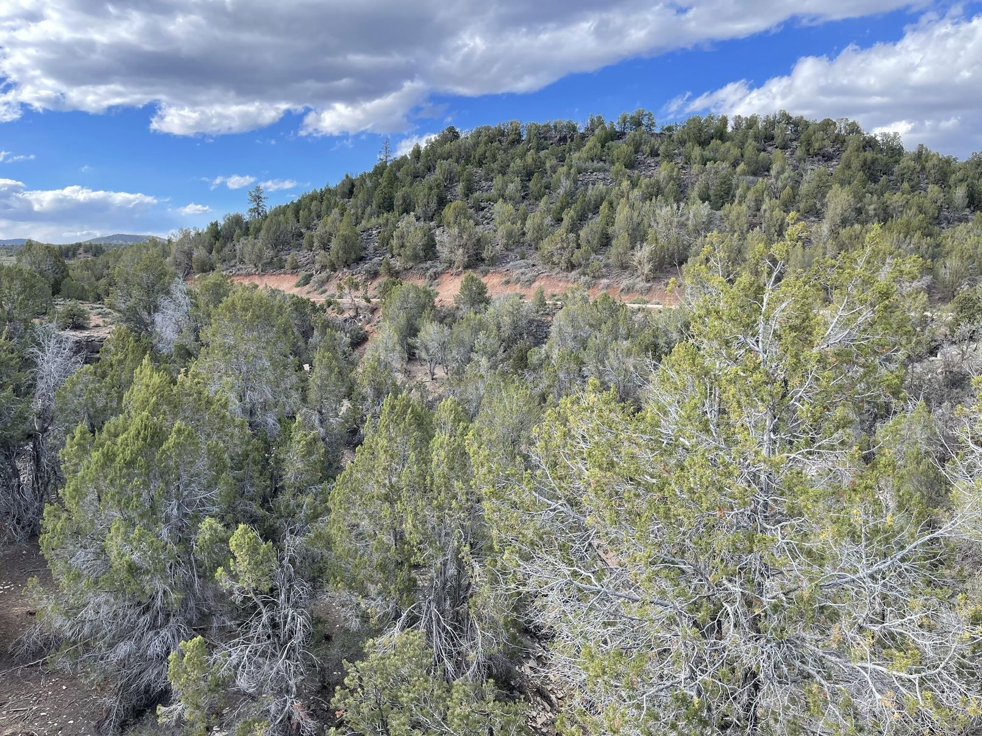





Influence of woodland encroachment on vegetation, soils, hydrology, and erosion on sagebrush rangelands
By: Trisha Jean Lane
Mentor: Jason Williams, Research Hydrologist, USDA-ARS Southwest Watershed Research Center
Funding Entities – USDA-ARS Southwest Watershed Research Center; USDI-Bureau of Land Management; University of Arizona – Arizona Space Grant Consortium
April 22, 2023
Arizona Space Grant Consortium Symposium

Slide 2
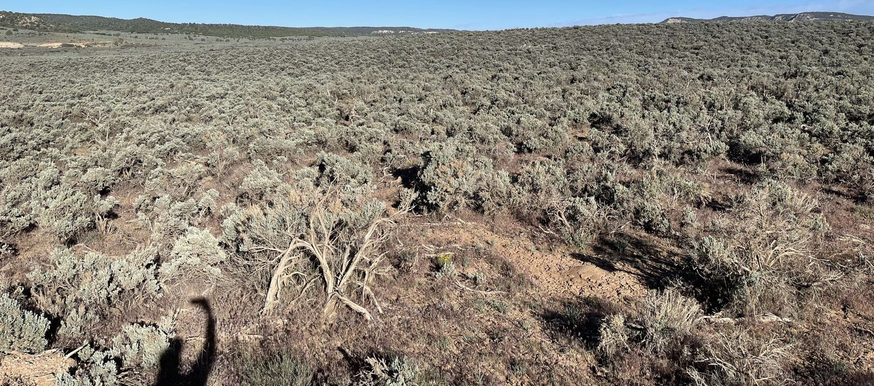
Woodland Encroachment into Sagebrush Steppe
Figure 1. Sagebrush Rangeland

Slide 3
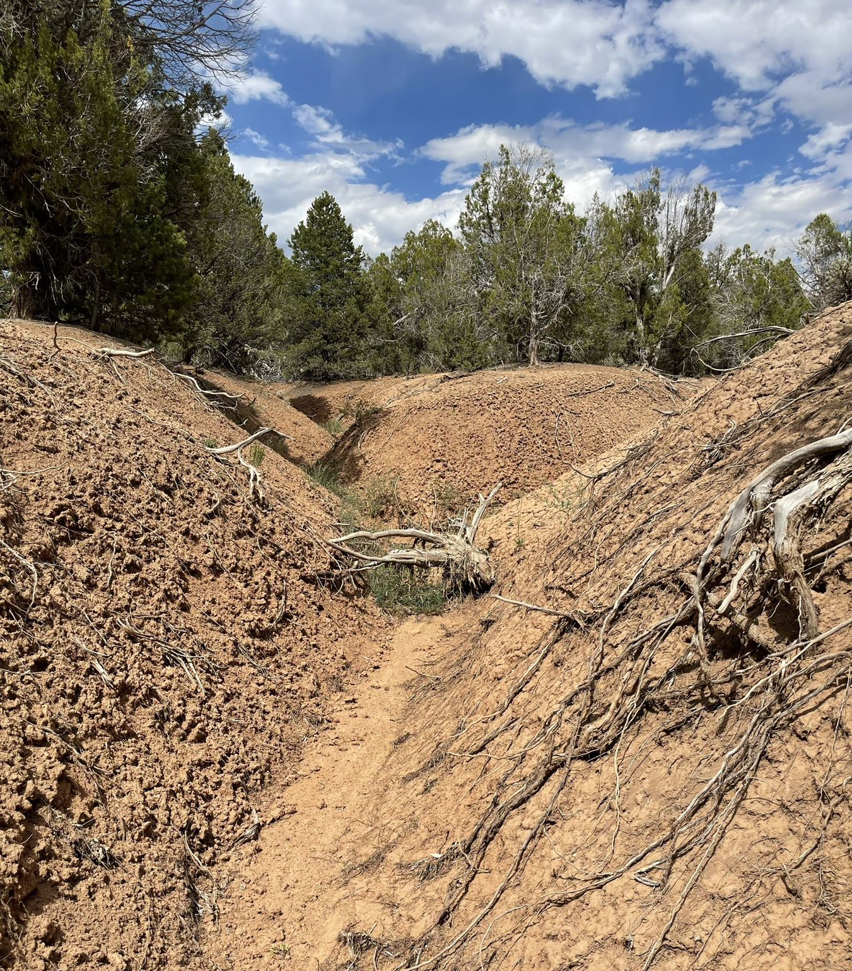
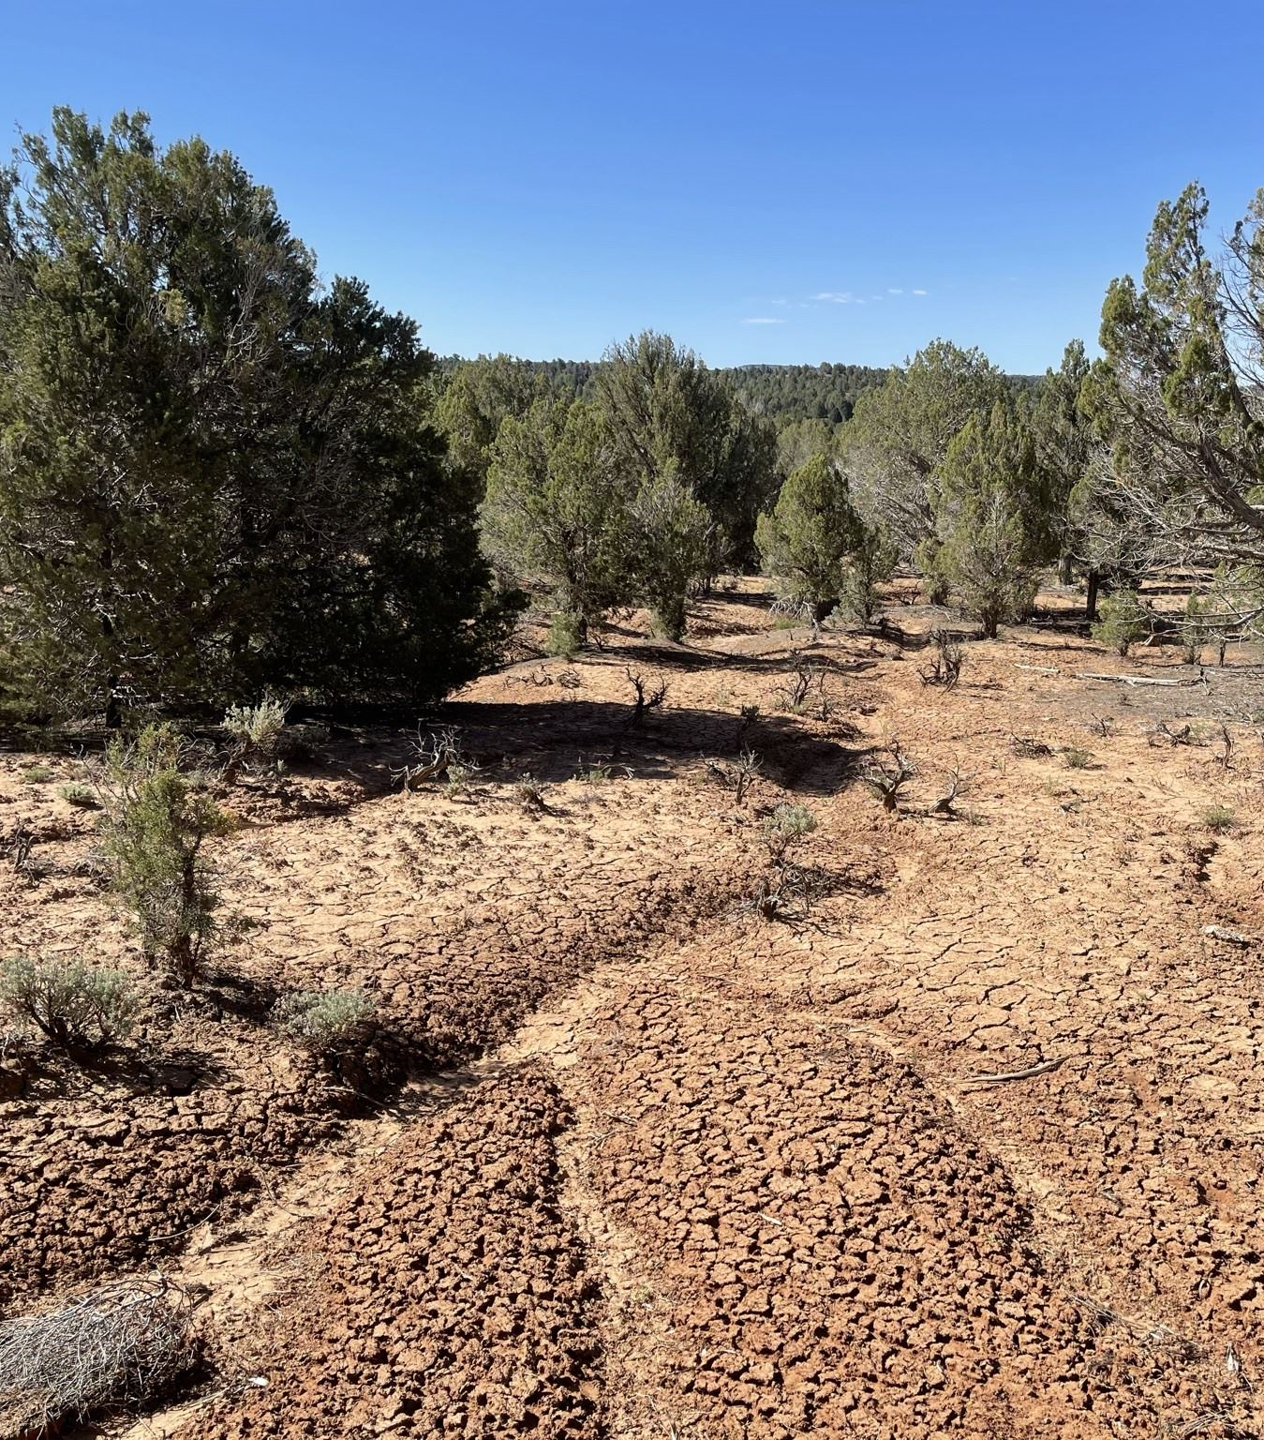
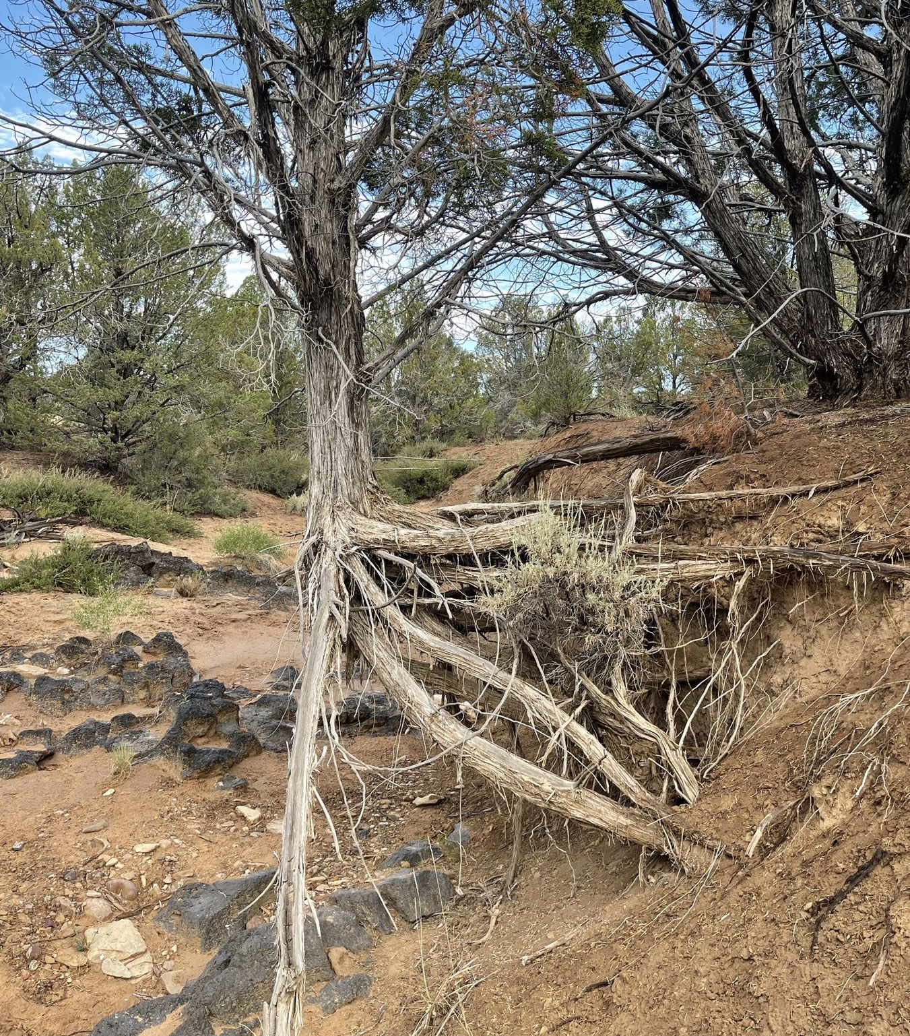
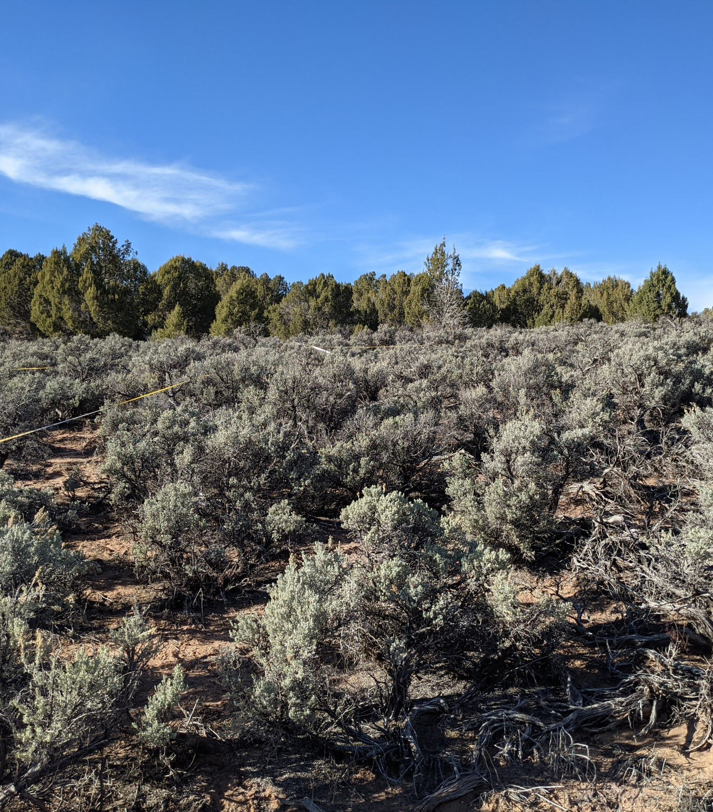
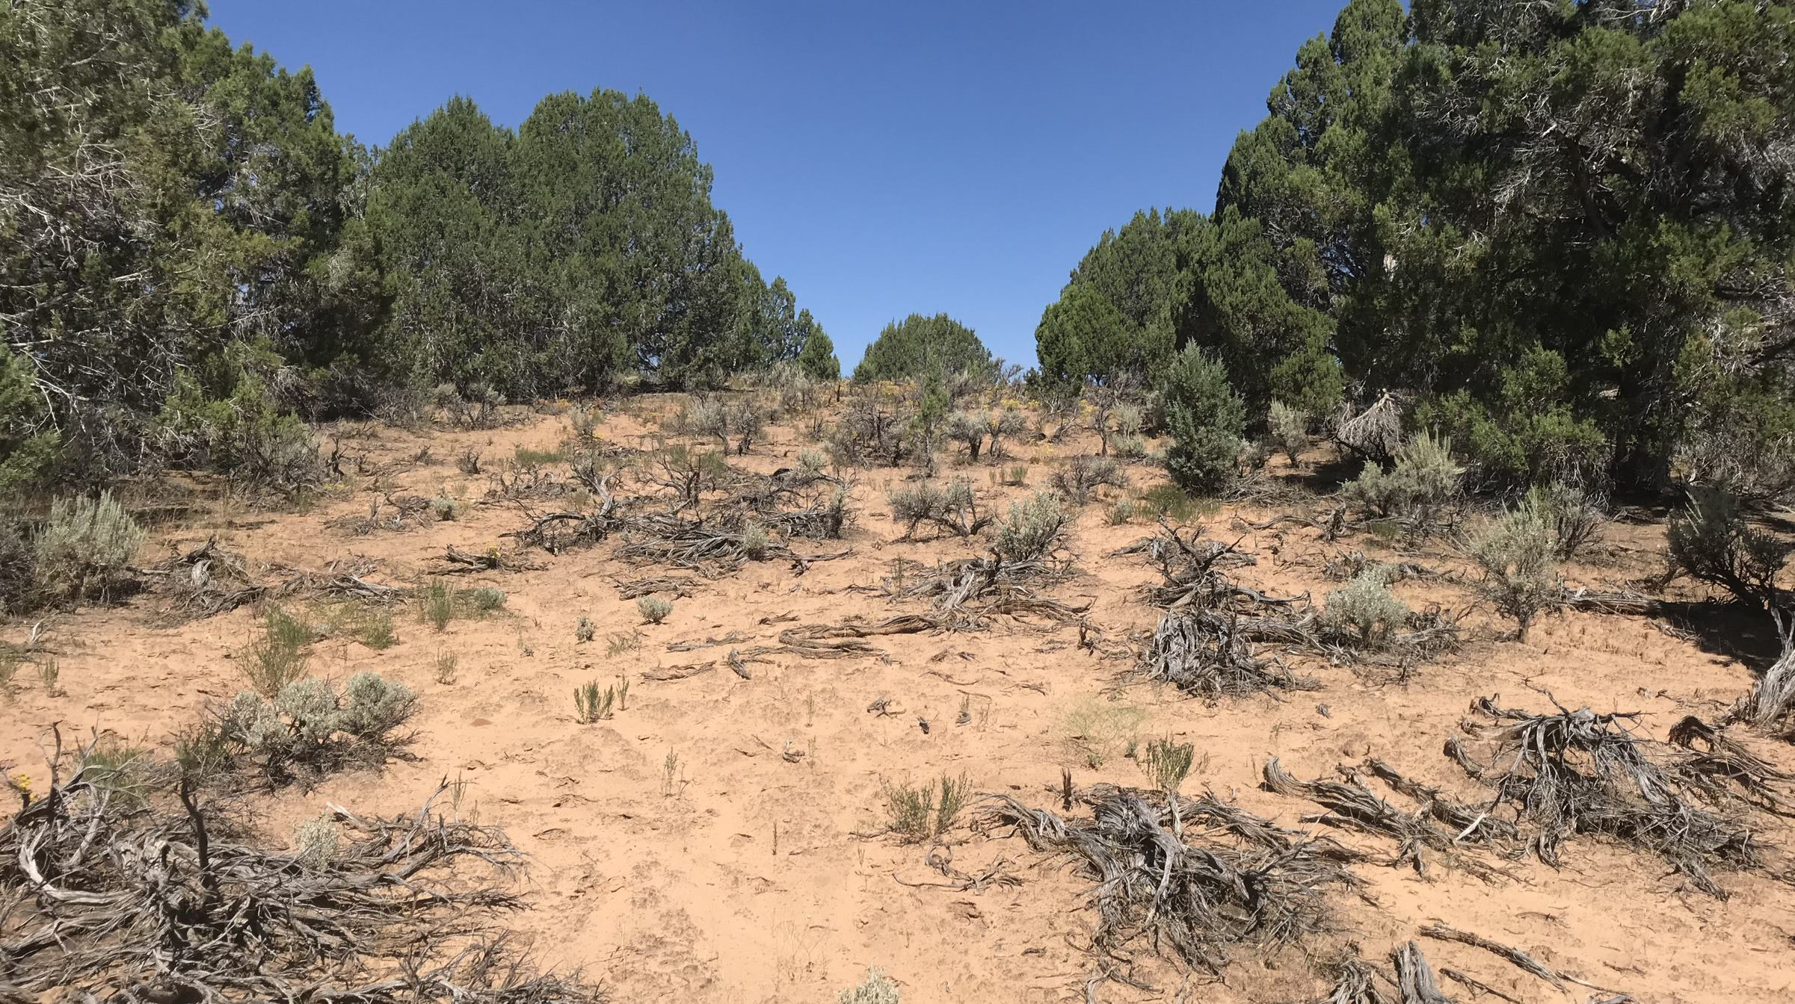
Woodland Encroachment into Sagebrush Steppe
Figure 2. Woodland with downslope channel erosion
Figure 3. Woodland with extensive bare area
Figure 4. Woodland with rills
Figure 5. Sagebrush Steppe
Reduced vegetation and ground cover
increased runoff, erosion, & soil loss.
Sustained reduction in delivery of ecosystem services.
Figure 6. Woodland with dead sagebrush

Slide 4
Problem
Land managers at Grand Staircase Escalante National Monument and elsewhere need an improved understanding of the impacts of woodland encroachment on vegetation, hydrology, and erosion processes to aid management decisions and guide conservation planning.
Field studies to assess woodland encroachment effects are commonly resource-demanding and logistically challenging.
The Rangeland Hydrology Erosion Model (RHEM) has recently been evaluated for predicting the effects of woodland encroachment on hydrology and erosion and provides a useful tool for assessing impacts and guiding management.

Slide 5
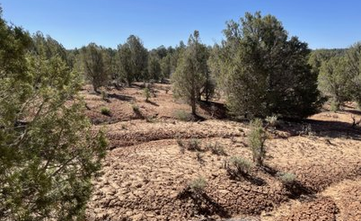
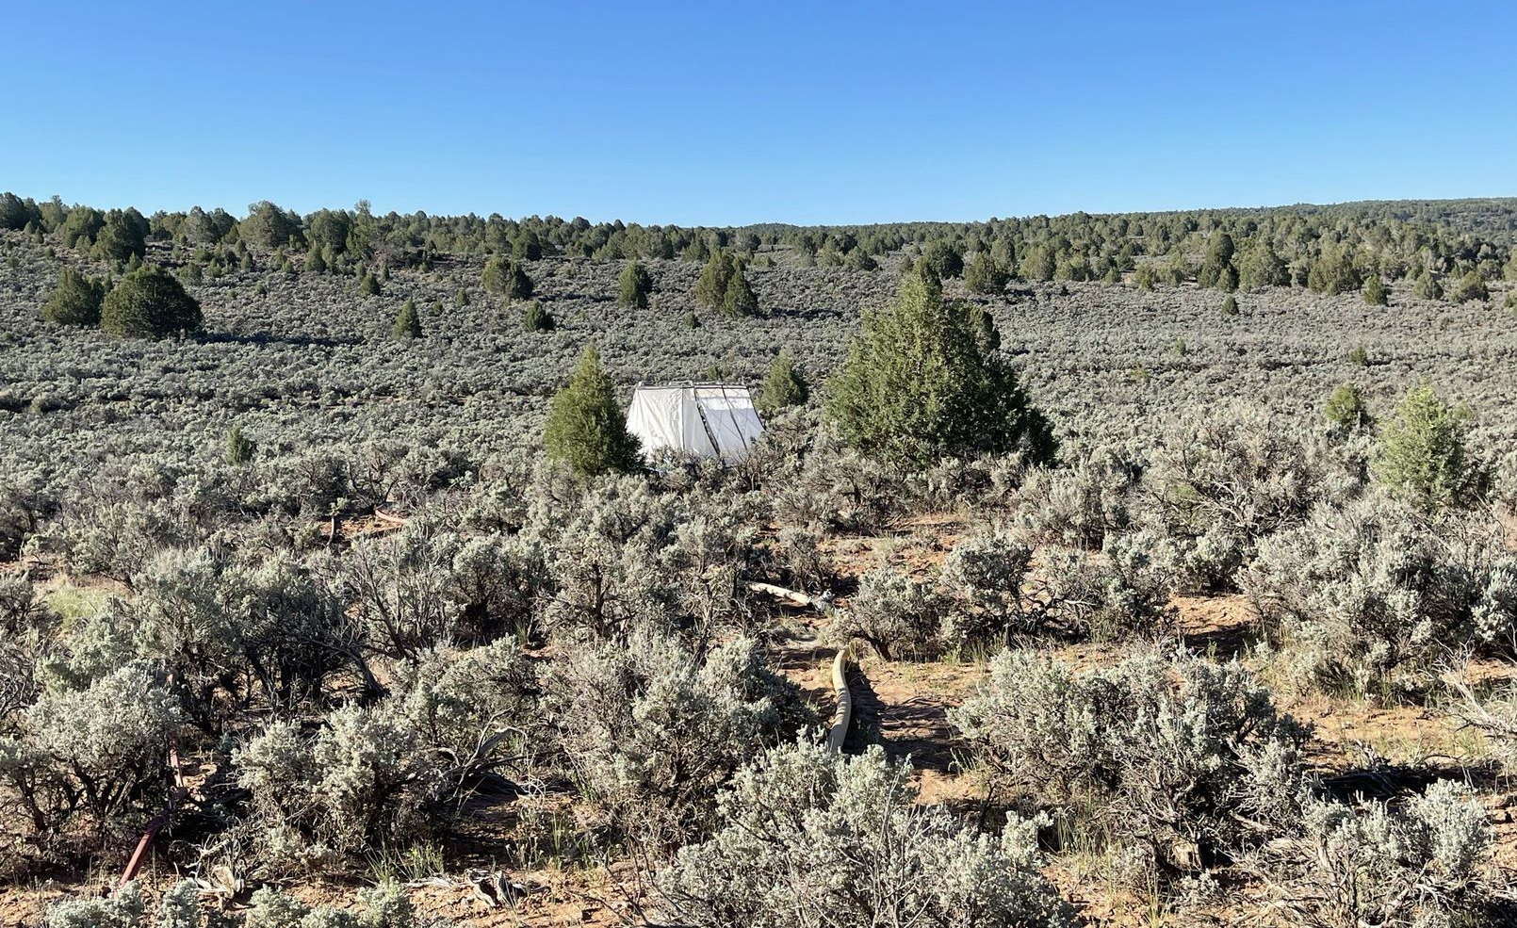
Study Area
Grand Staircase Escalante National Monument
Site info:
Latitude: 37.27°; Longitude: -112.37°
Elevation: 1840 m
Annual Precipitation: 400 mm; Annual Air Temperature 10°C
Vegetation:
Sagebrush steppe
Pinyon-Juniper Woodland (Woodland-Encroached Sagebrush Steppe)
Figure 7. Woodland study area
Figure 8. Sagebrush study area

Slide 6
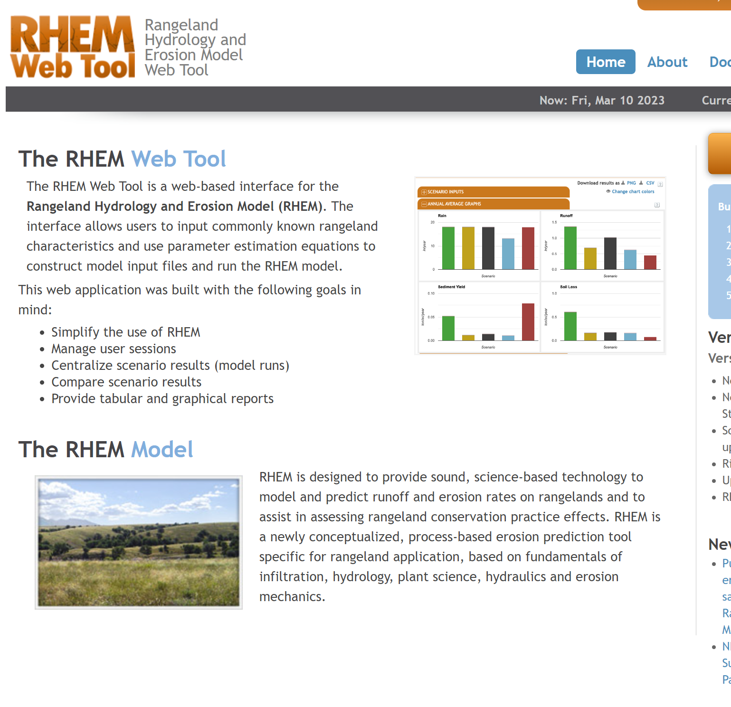
Research Purpose
GOAL:
Determine hillslope-scale ecohydrologic and erosion impacts of woodland encroachment on sagebrush rangelands at Grand Staircase Escalante National Monument.
Figure 9. Source: https://apps.tucson.ars.ag.gov/rhem/

Slide 7
Research Purpose
Specific Objectives:
Using commonly applied field methods, quantify woodland encroachment impacts on hillslope-scale vegetation structure and patch-scale vegetation and ground cover.
Quantify the impacts of woodland encroachment on hillslope-scale runoff and soil loss using patch-scale modeling with the RHEM web tool.
Figure 9. Source: https://apps.tucson.ars.ag.gov/rhem/

Slide 8
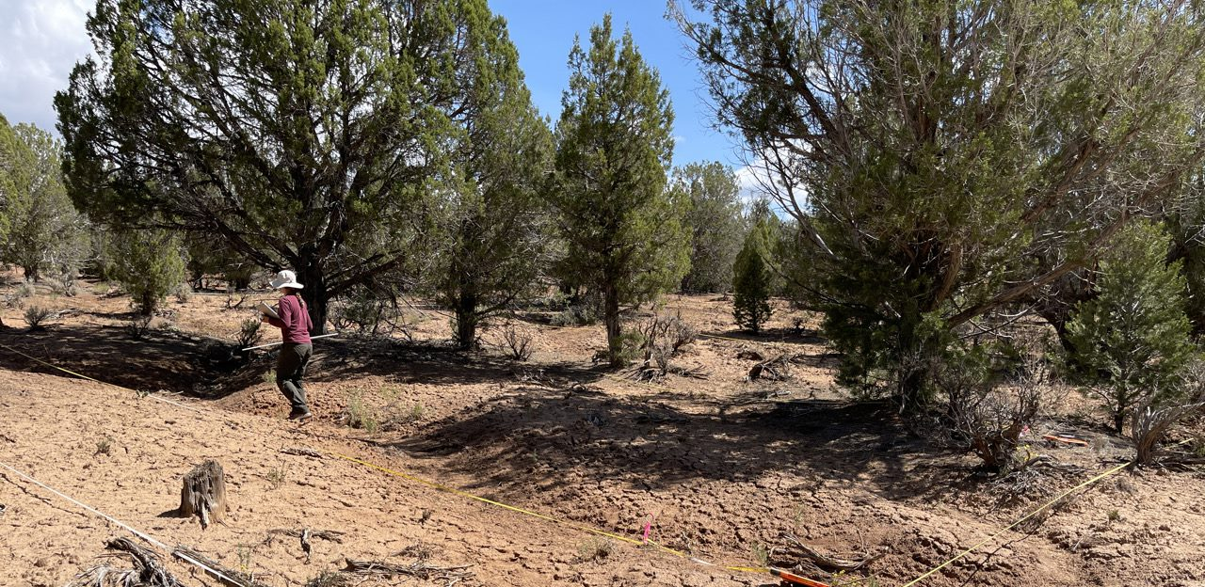
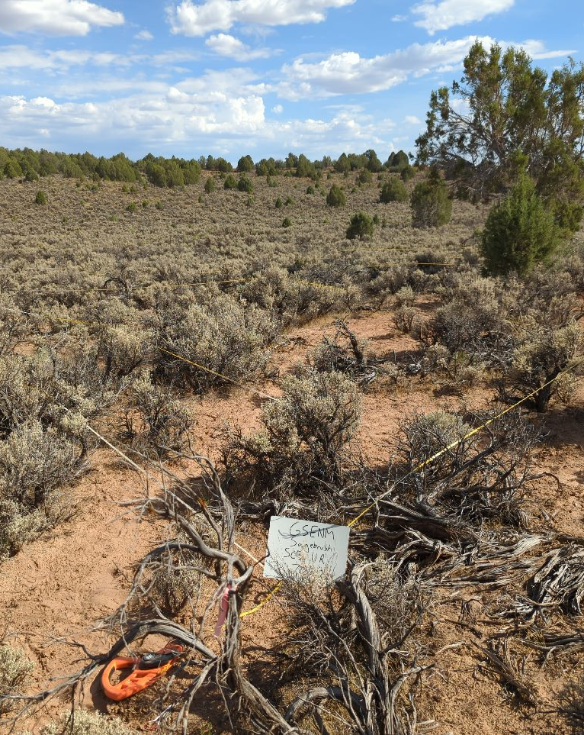
Methods: Quantify Vegetation Structure and Patch-Scale Vegetation and Ground Cover
Figure 10. Hillslope-scale LPI plot - Woodland
Applied commonly used line-point intercept (LPI) and soil sampling methods to quantify vegetation and ground cover conditions and soil properties:
Hillslope-Scale LPI Plots
Hillslope Scale - 33 m x 30 m plots; n = 3 per treatment
Figure 11. Hillslope-scale LPI Plot - sagebrush

Slide 9
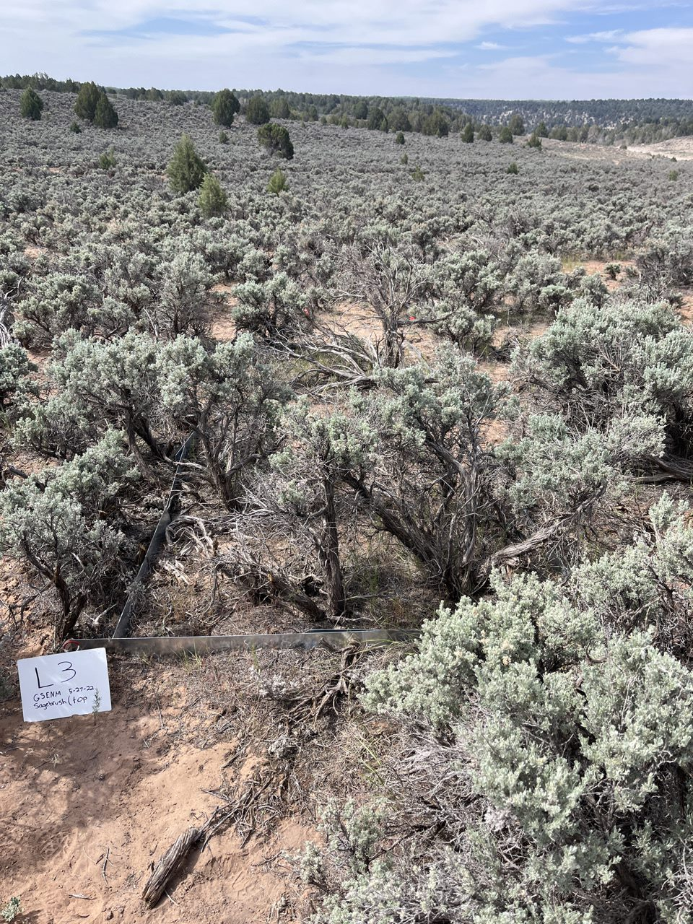
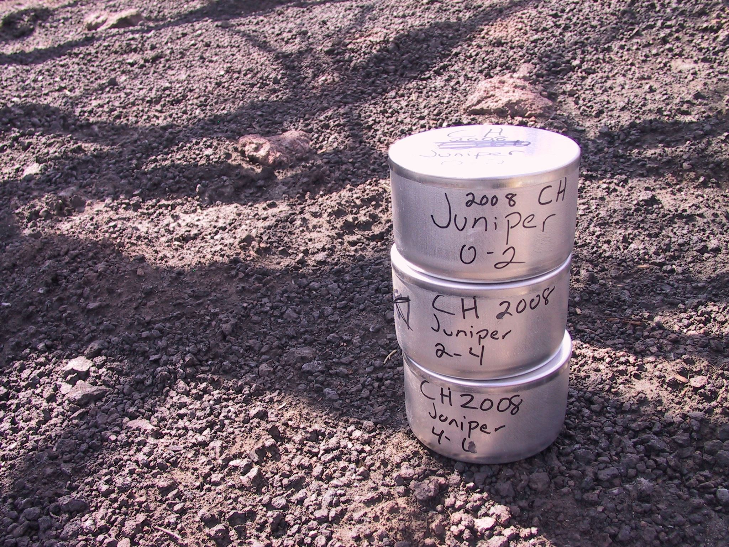
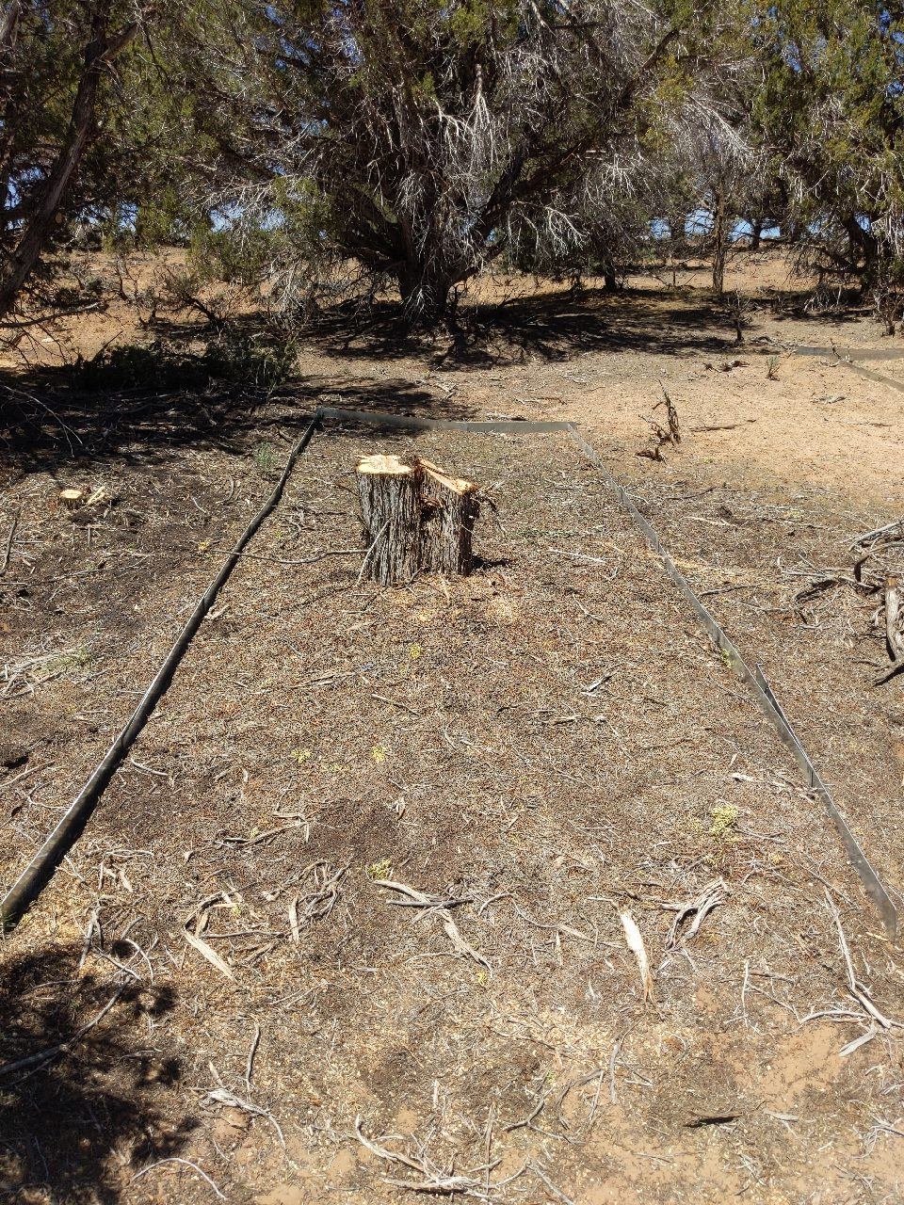
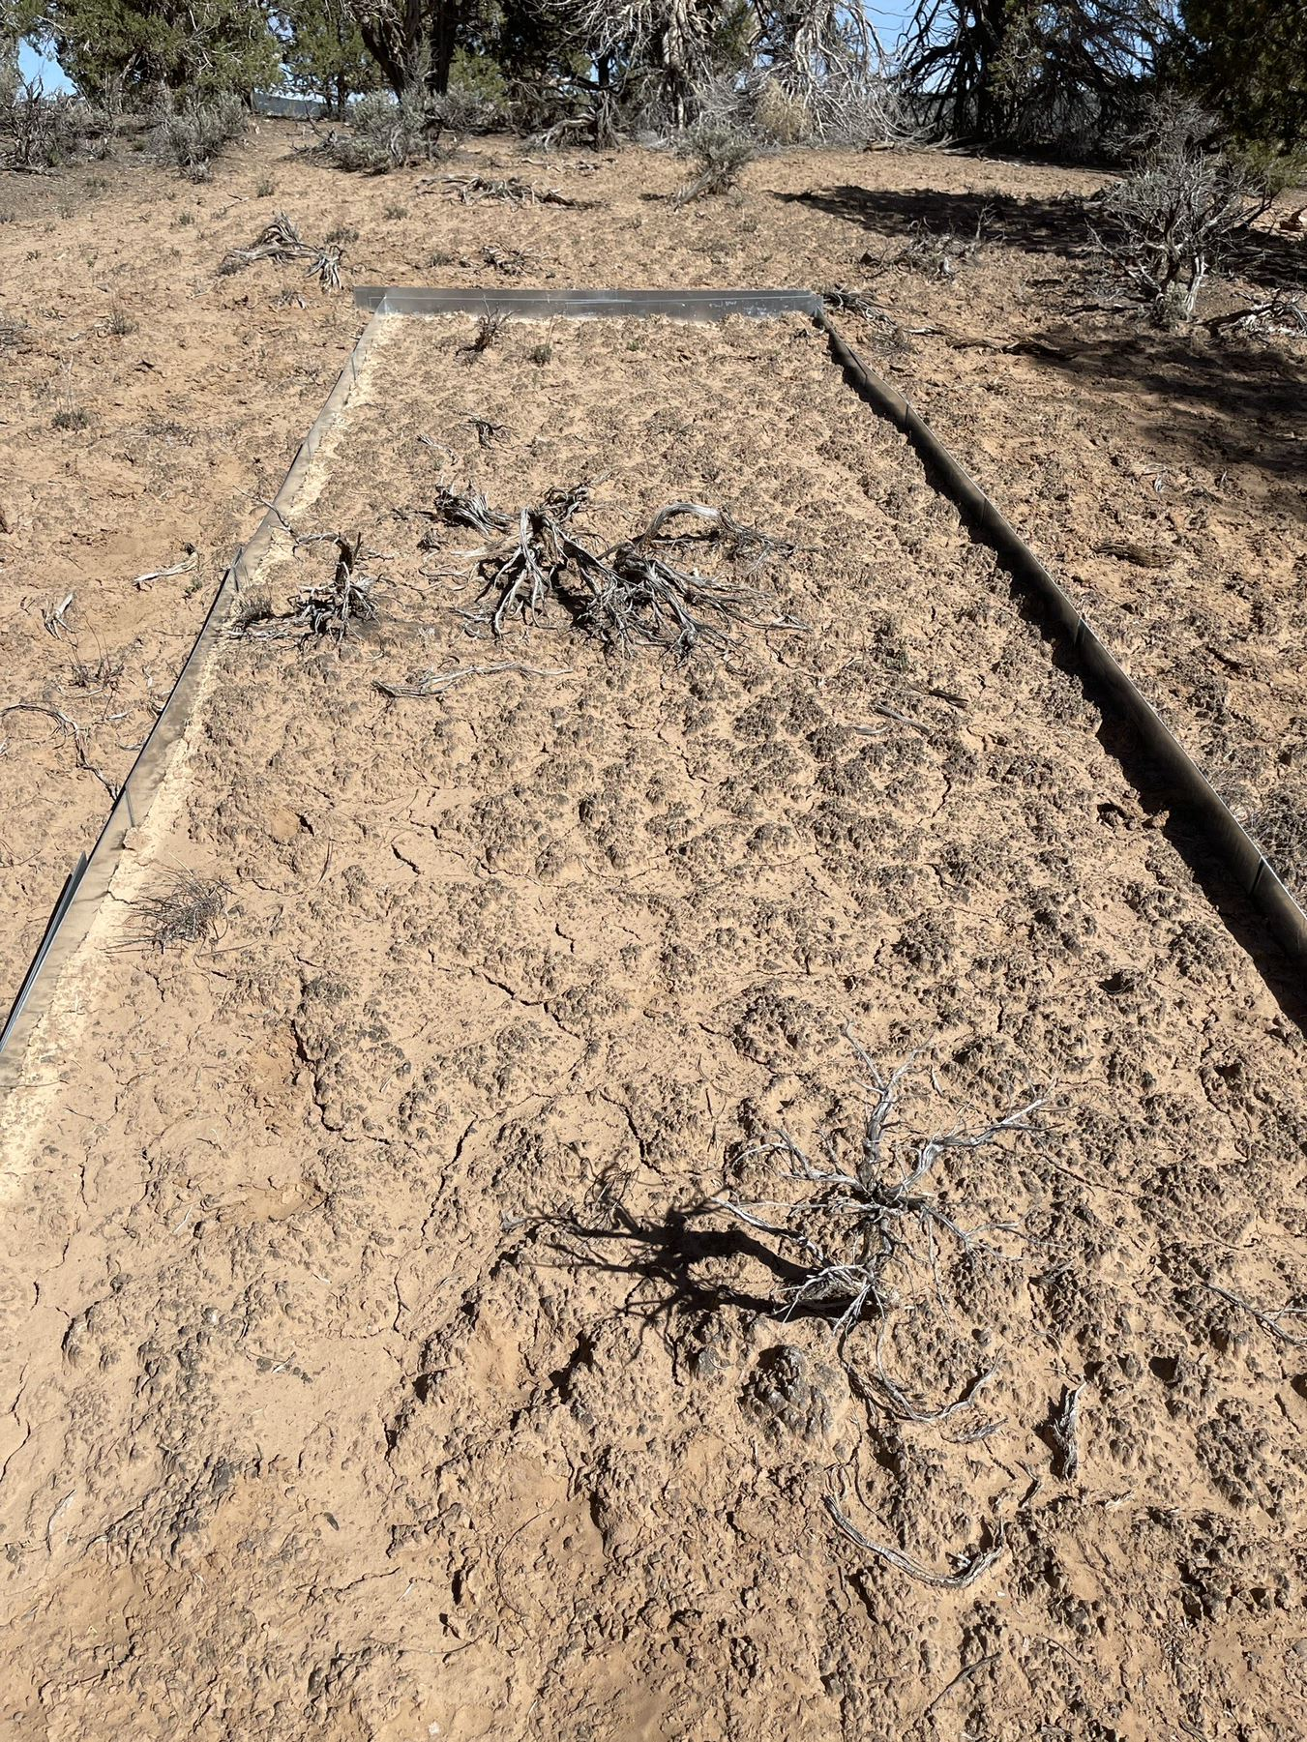
Methods: Quantify Vegetation Structure and Patch-Scale Vegetation and Ground Cover
Applied commonly used line-point intercept (LPI) and soil sampling methods to quantify vegetation and ground cover conditions and soil properties:
Patch-Scale LPI Plots
Patch Scale – 6 m x 2 m plots; n = 6 per microsite
Figure 15. Soil Cores (0-5 cm) For Texture
Figure 12. Patch-scale LPI Plot - Sagebrush
Figure 13. Patch-scale LPI Plot – Tree canopy
Figure 14. Patch-scale LPI Plot - Intercanopy

Slide 10

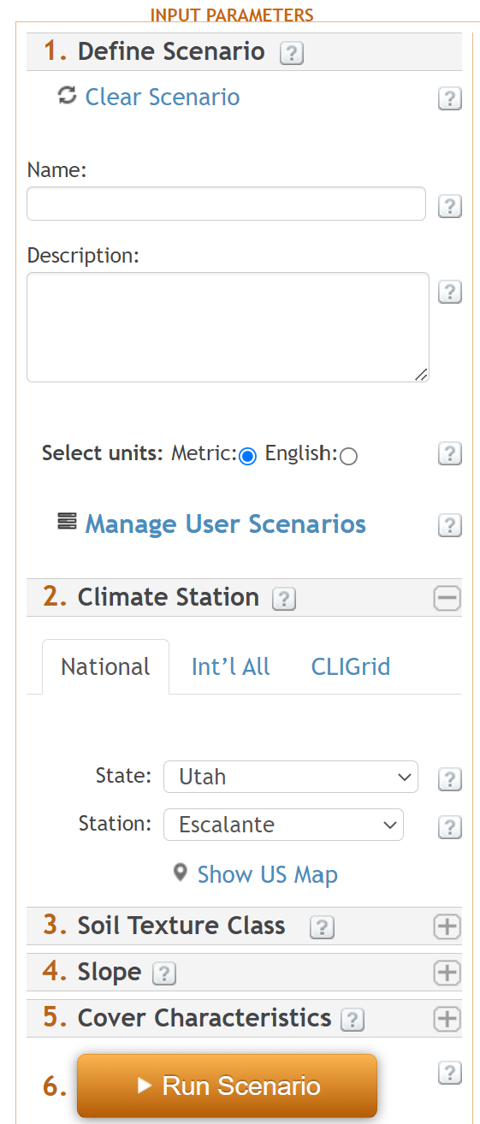
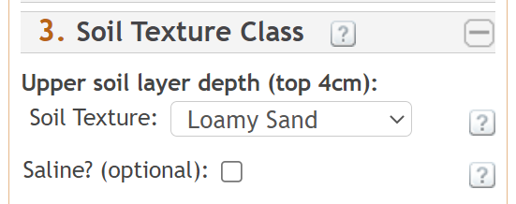
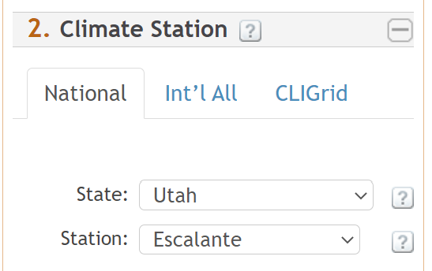
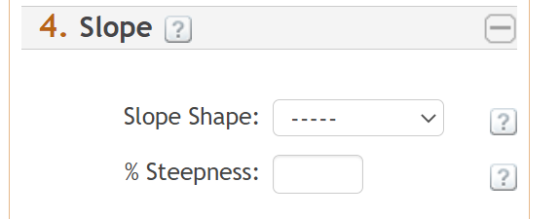
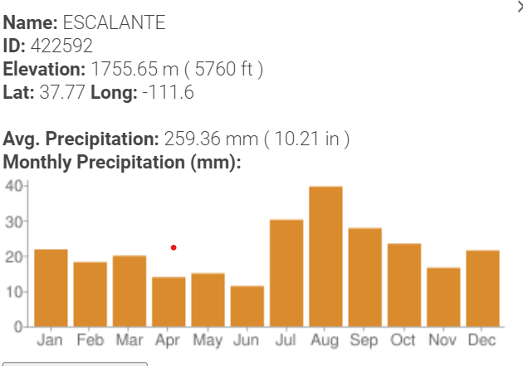
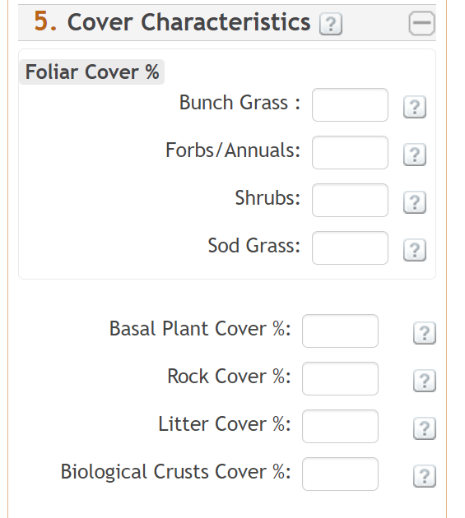

Methods: RHEM Patch-Scale Runoff and Sediment Yield Modeling
RHEM used to predict runoff and sediment yield for each patch-scale plot.
RHEM requires the following user inputs:
User-specified scenario ID
User selected climate station from an internal list
soil texture class
slope angle and shape
cover characteristics.
https://apps.tucson.ars.ag.gov/rhem/tool

Slide 11
Methods: RHEM Patch-Scale Runoff and Sediment Yield Modeling
RHEM applied for runoff and sediment yield prediction for each patch-scale plot using:
Representative climate station
Field-measured soil texture – loamy sand
Field-measured plot slope angle and shape
Field-measured (LPI) foliar and ground covers
https://apps.tucson.ars.ag.gov/rhem/tool

Slide 12
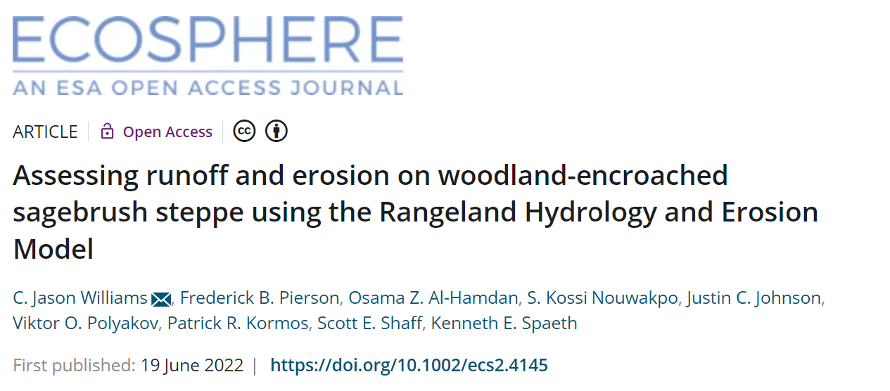
Methods: RHEM Hillslope-Scale Runoff and Sediment Yield Modelling
Williams et al. 2022 –
Ecosphere 13:e4145
Using methods from Williams et al. 2022, Woodland hillslope-scale runoff and sediment yield were determined as:
Figure 12. Sagebrush Hillslopes
For Sagebrush, hillslope-scale runoff and sediment yield estimated as mean of all sagebrush patch-scale model runs (n = 6).
Figure 13 & 14 Woodland Hillslopes – Area weighted based Tree Canopy & Intercanopy Area
Mean of all patch-scale tree canopy woodland runs (n= 6) x fractional tree canopy cover (woodland area covered by trees, 32%)
Mean of all patch-scale intercanopy woodland runs (n= 6) x fractional intercanopy area (woodland intercanopy area, 68%)

Slide 13
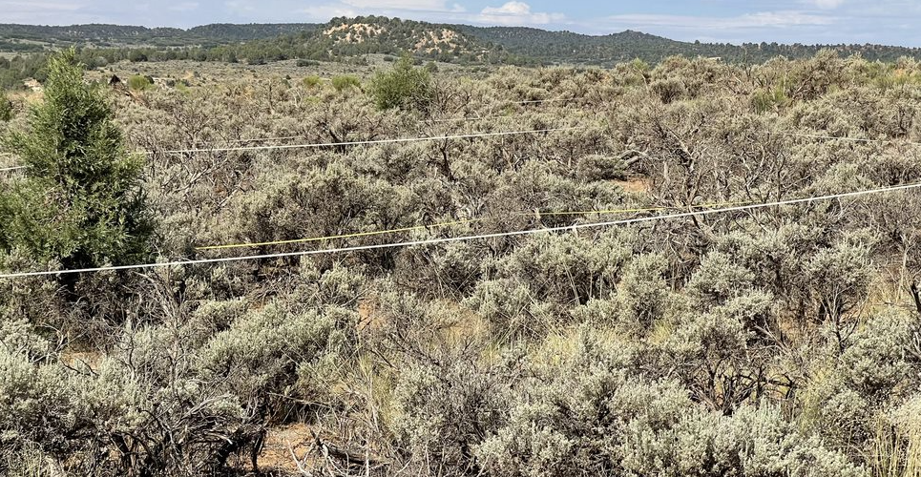
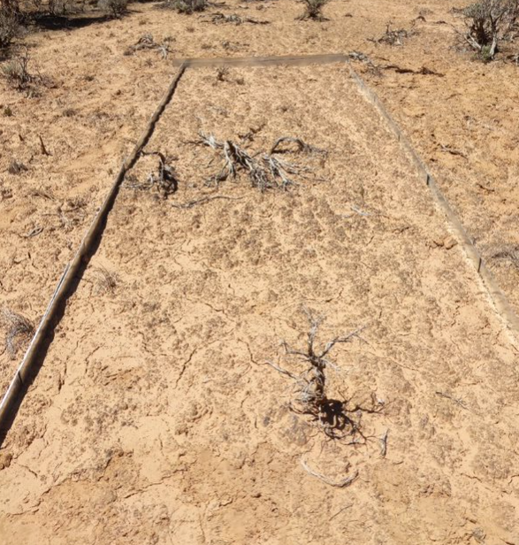
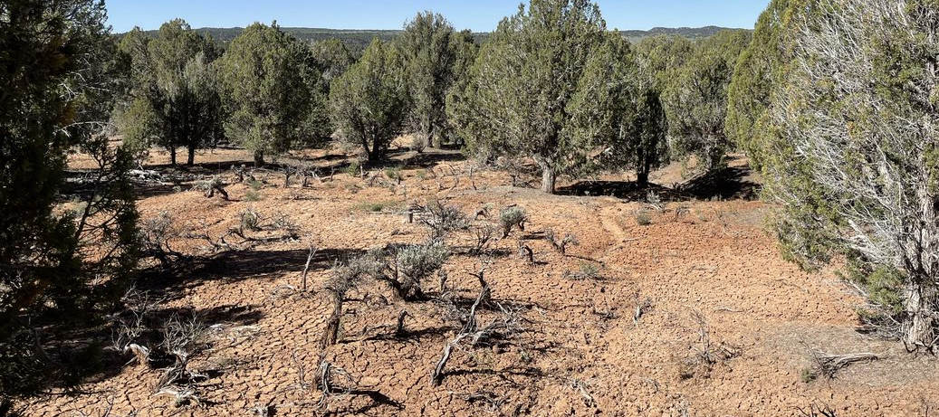
Results: Woodland Encroachment Impacts on Vegetation Structure and Canopy and Ground Cover
Coarse scale
2 m x 6 m plots
Site characterization = hillslope 33 m x 30 me plots
Average Bare ground cover Sagebrush Characterization site: 36.1 %
Average crust cover: 13.8%
Figure 16. Sagebrush Characterization site
Average Bare ground cover in woodland for site characterization plots: 36.5 %
Average crust cover: 22.8%
Figure 13. Plot L13 – Interspace
Bareground cover: 33.3%
Crust cover: 59.4%
Figure 17. Woodland Characterization site

Slide 14
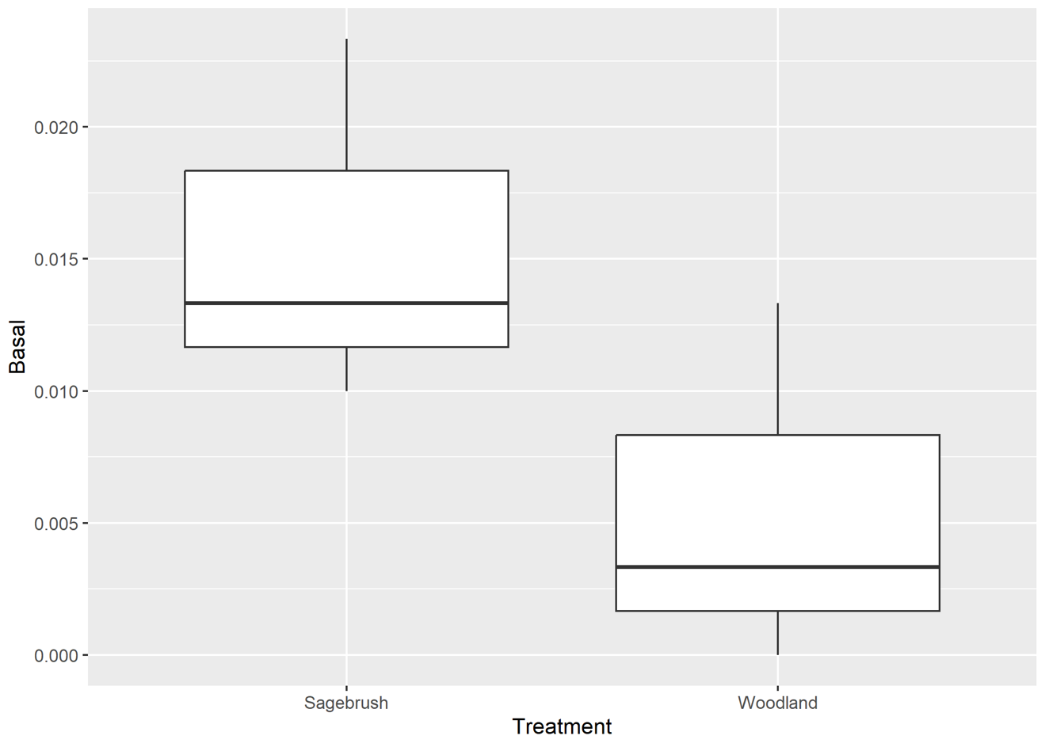
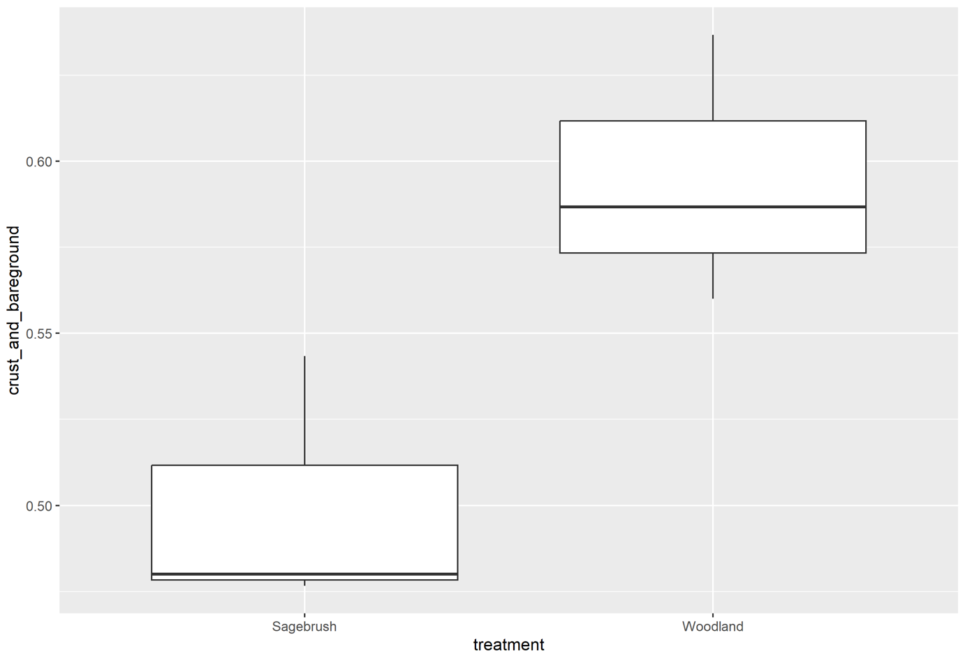
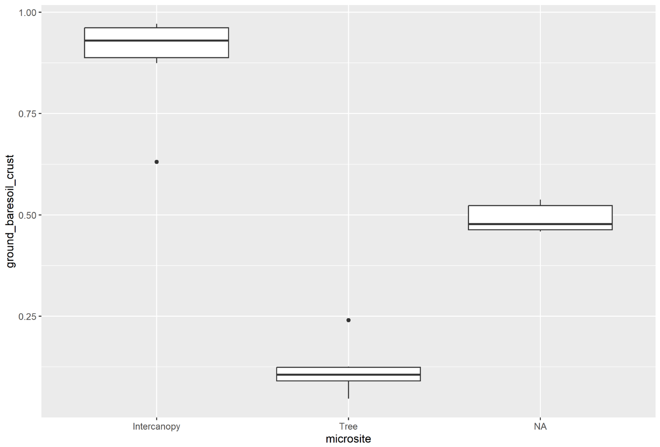
Results: Woodland Encroachment Impacts on Vegetation Structure and Canopy and Ground Cover
Woodland encroachment negatively impacts cover and increases bare ground
Site Characterization Plot
Site Characterization Plot
Coarse Scale
Graph 1. Basal Cover
Graph 2. Crust and bare ground cover
Graph 3. Ground Bare soil crust on course scale

Slide 15
Results: Woodland Encroachment Impacts on Runoff and Sediment Yield
Runoff
(Graph 4 & 5)
little difference between sagebrush and woodland
weighted – tree microsites are stable
Sediment Yield
(Graph 6 & 7)
noticeable difference especially in inter-canopy areas.
Graph 4. Runoff RHEM Results for 25-year return interval
Graph 5. Runoff RHEM Results for 100-year return interval
Graph 6. Sediment RHEM Results for 25-year return interval
Graph 7. Sediment RHEM Results for 100-year return interval

Slide 16
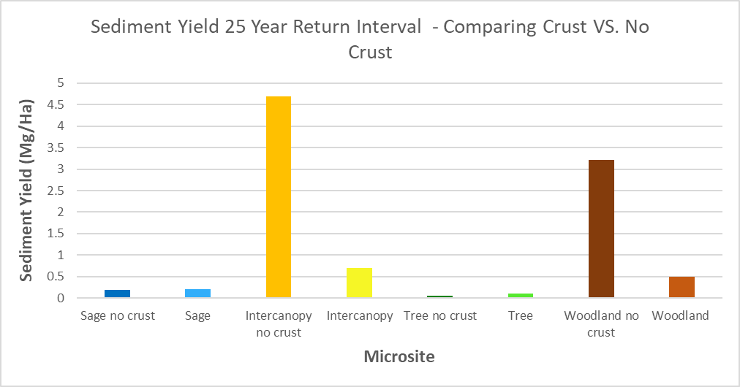
Results: Woodland Encroachment Impacts on Runoff and Sediment Yield
Crust cover is crucial to preventing erosion in the woodland
Woodland is less resilient than the sagebrush site regarding surface disturbance
Graph 8. Sediment yield 25-year return interval of crust cover.
Darker color = no crust
Lighter color = crust

Slide 17
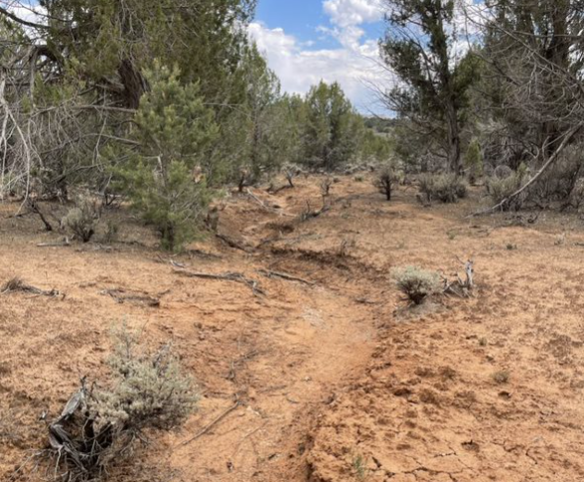
Conclusions
The sagebrush site generally provides greater utility (better provision of ecosystem services) in terms of sage grouse habitat, forage for wild/domestic grazing, resilience to disturbance
sagebrush site is more stable in terms of hydrologic function and erosion prevention.

Slide 18
Acknowledgements
Jason Williams, Arizona Space Grant Consortium Research Mentor
Erin Phelps, Arizona Space Grant Consortium Grad Student Mentor
Michelle Coe, University of Arizona - Arizona Space Grant Consortium Manager
Dr. Chandra Holifield Collins, University of Arizona - Arizona Space Grant Consortium Program Manager
Jacob Blais, Arizona Space Grant Consortium Undergraduate Intern Advisor
Arizona Space Grant Consortium fellow interns

Slide 19
Thank you!
Trisha Jean Lane
ttso@arizona.edu

